Slide 1
Elevator Control
Welcome To

Slide 2

Team Members
1- Omar Elsobkey
2- Ahmed Ragab
5- Ehab Ashraf
3- Ehab Samy
4- Mohamed Hosny
Supervisor: Dr-Tarek Ahmed

Slide 3
1- Frist Floor
Introduction
3- Third Floor
MATLAB Equations
5- Fifth Flour
Arduino Connection
2- Second Floor
Digital & Dahlin HS
4- Fourth flour
SIMULINK
6- Sixth Flour
GUI

Slide 4
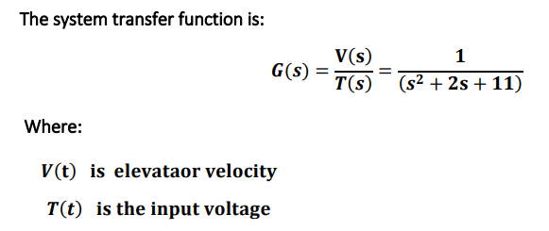

This Project to control Elevator System using known transfer function to model the tasks of project

Slide 5

Digital & Dahlin
HS

Slide 6
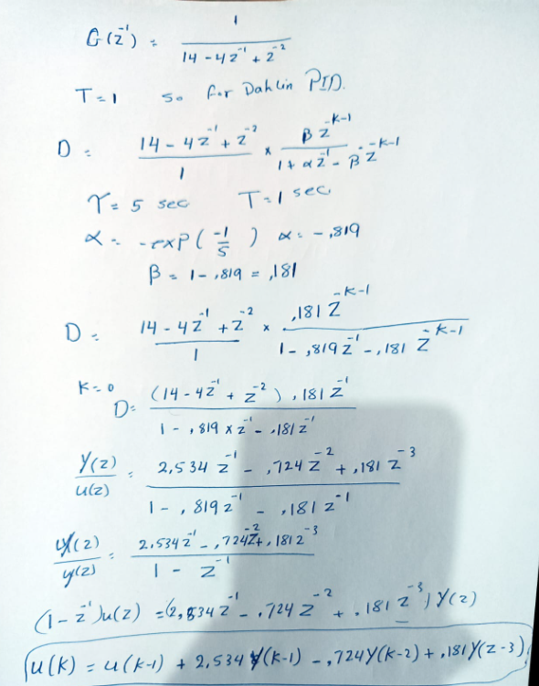
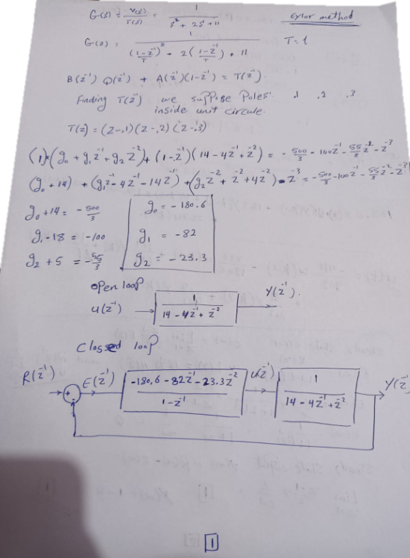
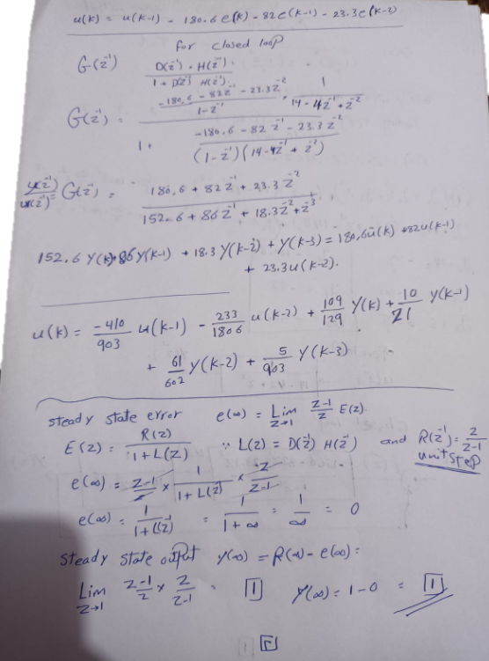

Slide 7

MATLAB
Equations

Slide 8
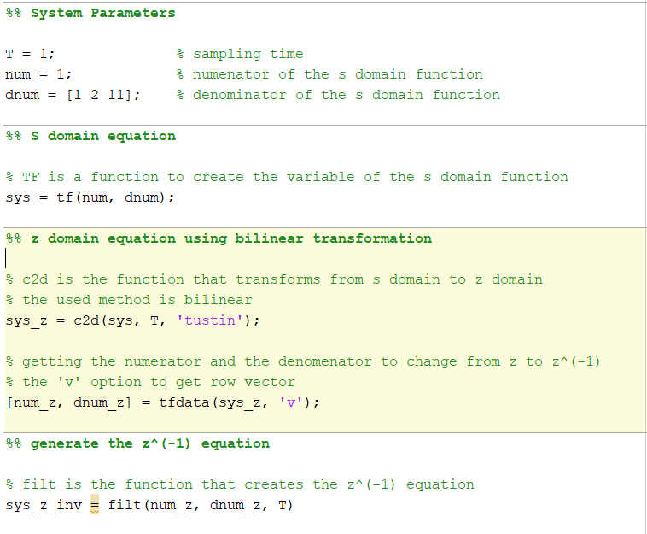

Converting T.F into z Domain

Slide 9
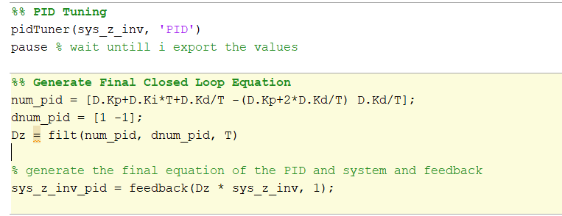
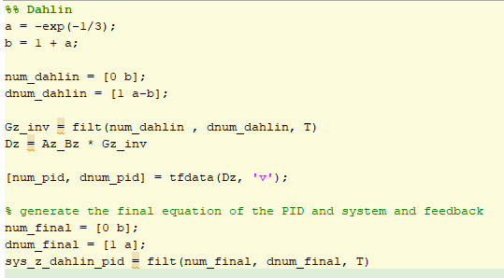
Digital Dahlin

Slide 10
4
SIMULINK

Slide 11
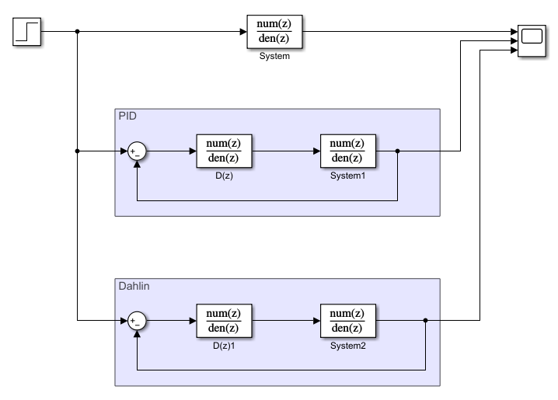
Simulink

Slide 12
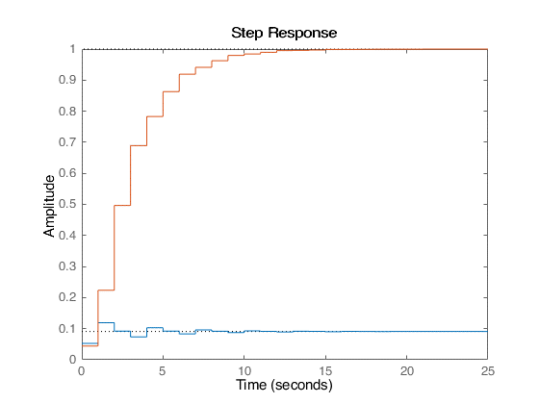
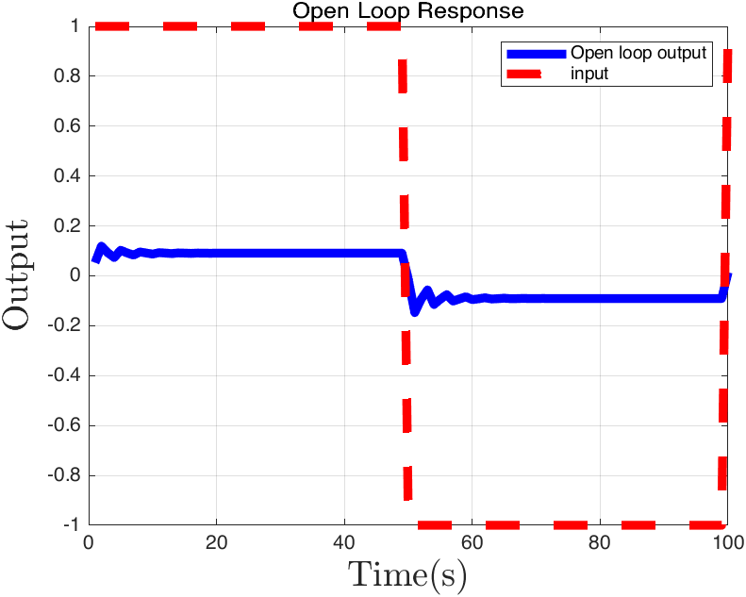
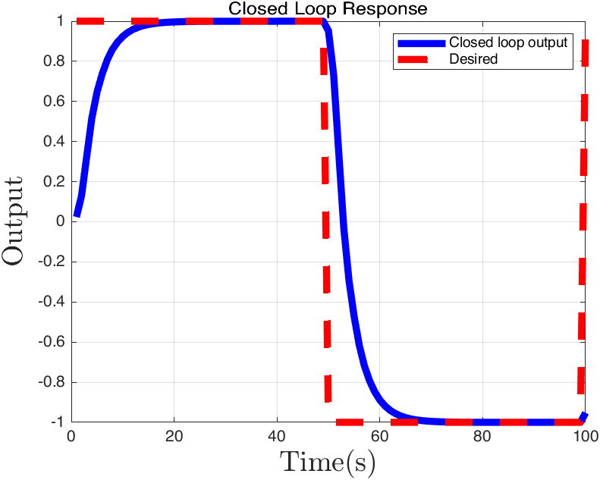

Slide 13
5
Arduino
Connection

Slide 14
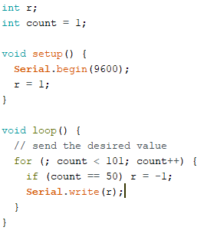
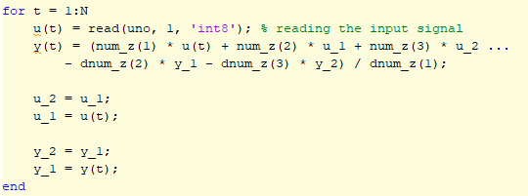
Open Loop

Slide 15
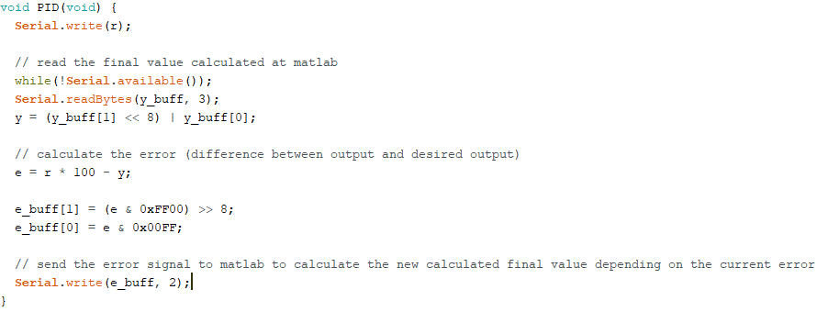
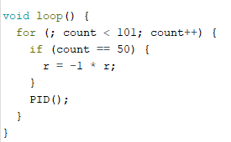
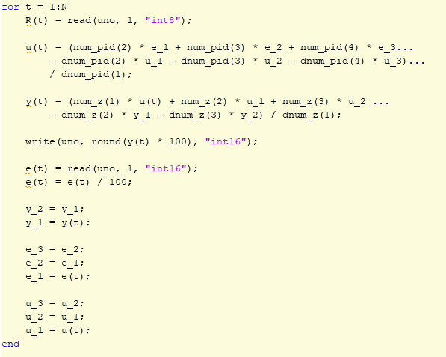
Closed Loop

Slide 16
6
GUI

Slide 17
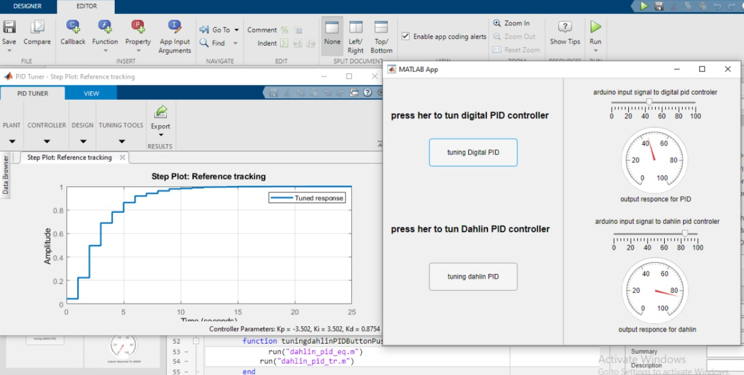

Slide 18
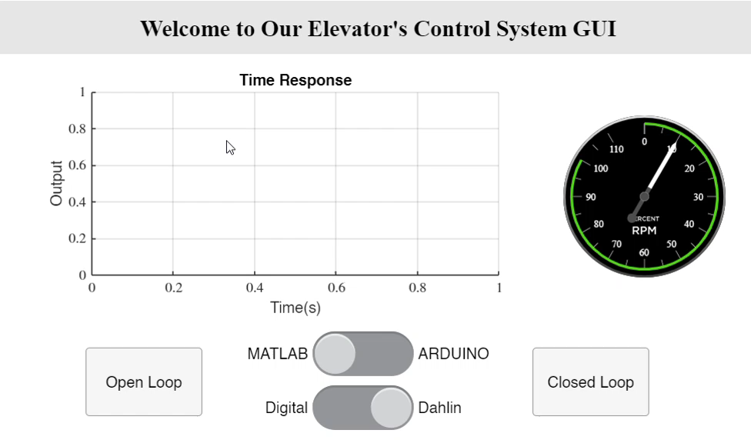

Slide 19


